Slide 1


I CARE- Interprofessional Student-run Primary CARE clinics:
A University-Enterprise Knowledge Triangle Cooperation Approach
Kick-off Meeting
February 12, 2021
Bassem Kaissi – VP for International Affairs
Ramona Nasr – Head of SHS Administration

Slide 2

Outline
MUBS faculties
School of Health Sciences Programs
  Nutrition
  Optometry
  Public Health
  Nursing
NWN- Clinics
Community Service Activities
  Rashaya Health Day
International Projects
  Project funded by WHO
  Virtual exchange program (MUBS and Cardiff Met.)
  Virtual exchange program (MUBS and Stanford)

Slide 3
Slide: # 1
MUBS Faculties
International School of Business (ISB)
British Academy in Lebanon
School of Computer and Applied Sciences (SCS)
School of Education and Social Work
School of Health Sciences (SHS)

Slide 4
Slide: # 2
International School of Business (ISB)
Undergrad Level
Bachelor in Business Administration
BBA (emphasis Accounting)
BBA (emphasis Banking and Finance)
BBA (emphasis Business Information Systems)
BBA (emphasis Management)
BBA (emphasis Marketing)
License en Science de Gestion de l’Entreprise
Graduate Level
Master in Business Administration (MBA)
Master en Management des Organisations (Université de Picardie Jules Verne – France)

Slide 5
Slide: # 3
Undergraduate
BA (Hons) in Business and Management Studies
Graduate
MBA Master of Business Administration
MBA Master of Business Administration in Project Management
MBA Master of Business Administration in Human Resource Management
MBA Master of Business Administration in Health Sector Management
MSc. Master of Science in Sport Management and Leadership
British Academy in Lebanon (BAL)

Slide 6
Slide: # 4
School of Computer and Applied Sciences (SCS)
Computer Science Department
Bachelor in Computer Science (BCS)
Master Degree in Computer Science (MCS)
Postgraduate diploma in traffic safety
Art & Design Department
Bachelor of Science degree in Graphic Design
Bachelor of Arts in Interior Design

Slide 7
Slide: # 5
School of Education and Social Work
Education Department
Bachelor in Early childhood Education
Bachelor in Educational Management
Bachelor in Education
Teaching Diploma (TD) programs
Social Work Department
Bachelor in Social Work
Master in Social Work

Slide 8
School of Health Sciences

Slide 9
Slide: # 7
Bachelor of Science in Nutrition and Dietetics
Bachelor of Science in Public Health
Bachelor of Science in Optometry and Vision Science
Bachelor of Science in Nursing

Slide 10
Slide: # 8
Nutrition and Dietetics
To get the BSc., the students should complete 97 credits:
  92 credits: Courses
  2 credits: Practicums (Food Service and Community /90 hours each)
  3 credits: Senior Project

Slide 11
Slide: # 9
Nutrition and Dietetics
The program prepares students to apply their knowledge of nutrition to promote healthy eating and lifestyle choices among individuals and groups as well as those with special nutritional needs.
Syndicate of Dietitians in Lebanon or Lebanese Academy for Nutrition and Dietetics

Slide 12
Slide: # 10
Optometry and Vision Science
To get the BSc., the students should complete 114 credits:
  107 credits: Courses
  4 credits: Practicums (I and II / 180 hours each)
  3 credits: Senior Project

Slide 13
Slide: # 11
Optometry and Vision Science
Students will be able to use visual aids, optical devices, and imaging techniques to fully evaluate how the visual system works.
Syndicate of Opticians and Optometrists

Slide 14
Slide: # 12
Public Health
To get the BSc. the students should complete 108 credits:
  101 credits: Courses
  4 credits: Practicums (I and II / 180 hours each)
  3 credits: Senior Project

Slide 15
Slide: # 13
Public Health
Designed to promote an interdisciplinary understanding of health and disease based on Public Health principles.
Explore both quantitative and qualitative aspects of Public Health at all levels of analysis.
Public Health students learn the methods in which the biological, social, psychological, environmental, and legal factors interact to influence human health.

Slide 16
Slide: # 14
Nursing
To get the BSc. the students should complete 108 credits:
  70 credits: Courses
  35 credits: Courses with Practicums
  3 credits: Senior Project

Slide 17
Slide: # 15
Nursing
The program prepares the students to the nursing profession and to become a licensed nurse. Students are given both theoretical instruction and an opportunity for clinical application of nursing skills as they prepare for entry-level practice as licensed nurses.
Syndicate of Nurses in Lebanon

Slide 18
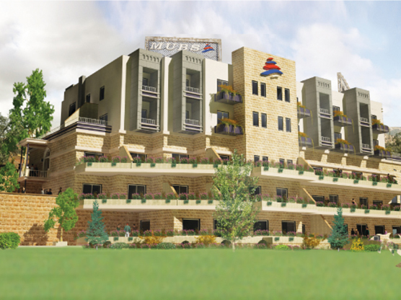
Slide: # 16
National Wellness Network -NWN
Organization established by the Modern University for Business & Science (MUBS).
Committed to improve the wellness of the community through the delivery of affordable, comprehensive state of the art health and wellness services of the maximum quality for individuals of all ages.
Notes:
with an objective to empower individuals to adopt and maintain healthy lifestyle behaviors.
The commitment extends to create and sustain a culture that educates, motivates, and empowers MUBS students, faculty, staff, and the community to adopt and maintain healthy lifestyle behaviors necessary for the fulfillment of their academic, occupational, and personal goals.

Slide 19
Slide: # 17
NWN Clinics
Specialty medical clinics
Optometry Clinics
Nutrition and Diet Clinics
Physical Therapy Center
Social Work Center
Sports Fitness and Center
Education and Awareness Center
Wellness and Ecotourism Center
Notes:
Specialty medical clinics:
Clinics consist of 3 main types:
Preventive clinic: work on awareness programs with society
Treatment clinic: treating diseases
education about disease, symptoms, ways of transmission and treatment regimen
Rehabilitation Clinic: rehabilitation programs
transfer to rehabilitation department
The Poly Medical Clinics offers multiple medical specialties provided by appointment in the fields of:
Orthopedics
Gastroenterology
Family Medicine
Neurology
Endocrinology & metabolism disorder
Geriatrics
Ophthalmology
2. Optometry Clinics
Full Eye Care Service
Vision Test (Visual Acuity Test, Objective & Subjective Vision Tests, Binocular Vision Tests).
Ophthalmologist Consultations
3. Nutrition and Diet Clinics
Body composition test
Medical Nutrition Therapy for: Diabetes, Hypertension, Metabolic syndrome, Dyslipidaemia, Renal disorders, Gastrointestinal problems, etc.
Healthy lifestyle promotion for: Children and adolescents, pregnant women, women in menopause, etc.
4. Physical Therapy Center
The physical therapy department aims to help patients reach the maximum potential for their individual physical needs and abilities.in our physical therapy center, we treat neurological conditions in addition to orthopedic, vestibular, geriatric

Slide 20
Slide: # 18
Students involved in community services (MUBS_NWN)
Organize health awareness days for schools in all regions in Lebanon.
Collaborate with NGOs and municipalities to organize health awareness days to people in rural areas in Lebanon
Collaborate with NGOs and UN to organize health awareness days for Syrian and Palestinian refugees in Lebanon
Visiting rural underprivileged villages and voluntary serving its inhabitants
  Provide free medical services to schools students
  Offer free awareness sessions about topics related to physical and mental health

Slide 21
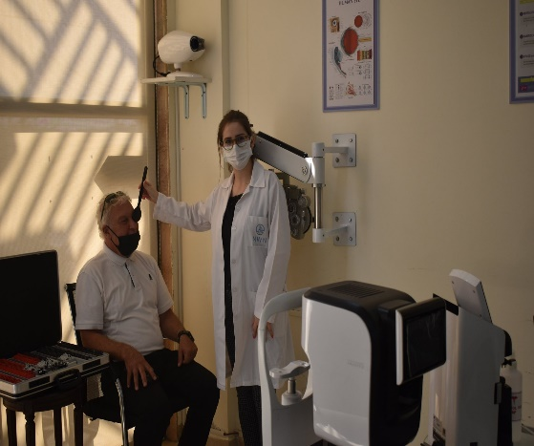
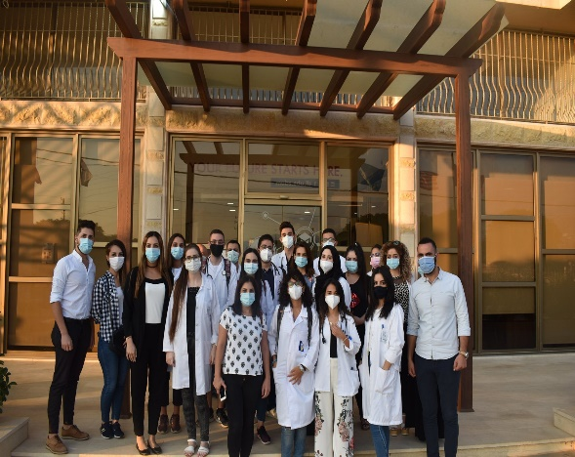
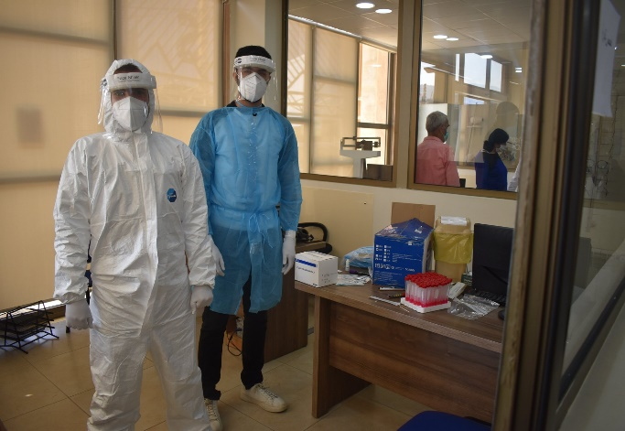
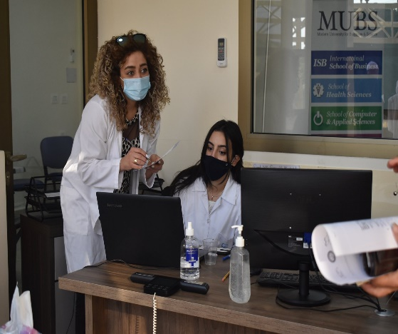
Slide: # 19
MUBS Health Day (Rashaya Campus)
The Rashaya Health Day brought out nearly 150 people to the Modern University for Business and Science (MUBS) in Rashaya campus.
Over thirty-five volunteers and employees from MUBS, National Wellness Network (NWN), and The Lebanese Medical Students' International Committee (LeMSIC) gathered on October 4, 2020 to take part in this event.
The event was a joint creation of MUBS and NWN with the support of other partners to promote wellness and health. The goal was to provide people in the region with medical care including blood tests and Covid-19 Rapid Antigen Test.

Slide 22
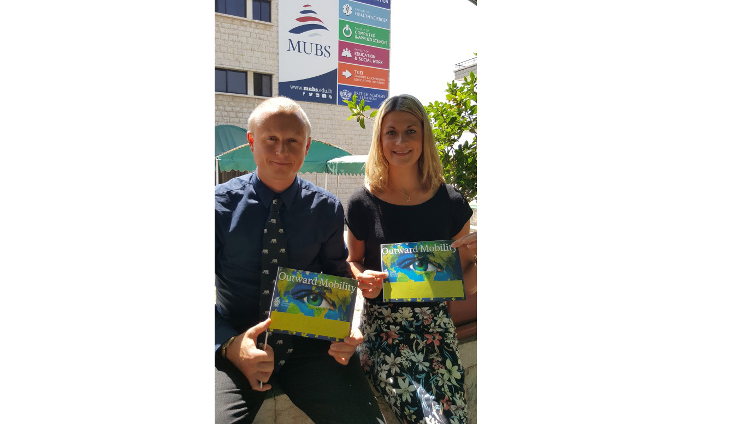
Slide: # 20
International Projects
SHS is very active in international projects funding including Erasmus+, World Health Organization (WHO),…

Slide 23
Slide: # 21
Project Funded by WHO: Supporting School Health in Disadvantaged Rural Areas
MUBS received a grant from the World Health Organization (WHO) to work jointly with Champs NGO and leading scholars to support school health in disadvantaged rural areas.
The pilot project took place in five public schools located in South Lebanon and Bekaa.
It has three main pillars:
- Medical Screening (visual acuity, body mass composition analysis, EKG, etc.)
- Health Education in Schools (e-modules set by WHO)
- Health Environment (School environment, activities carried out, status on infrastructure in schools)

Slide 24
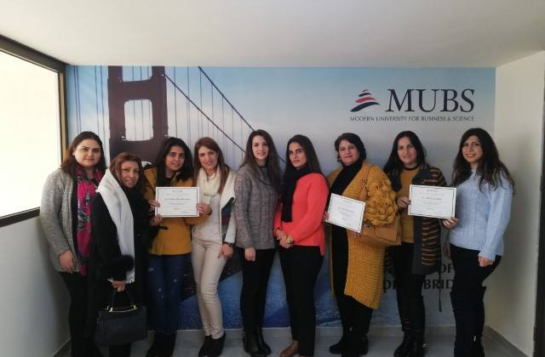
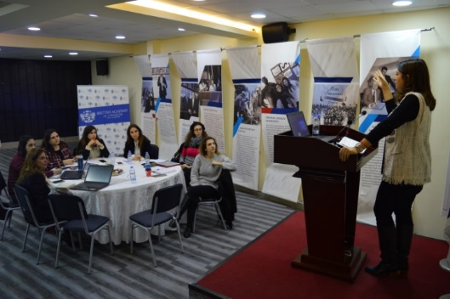
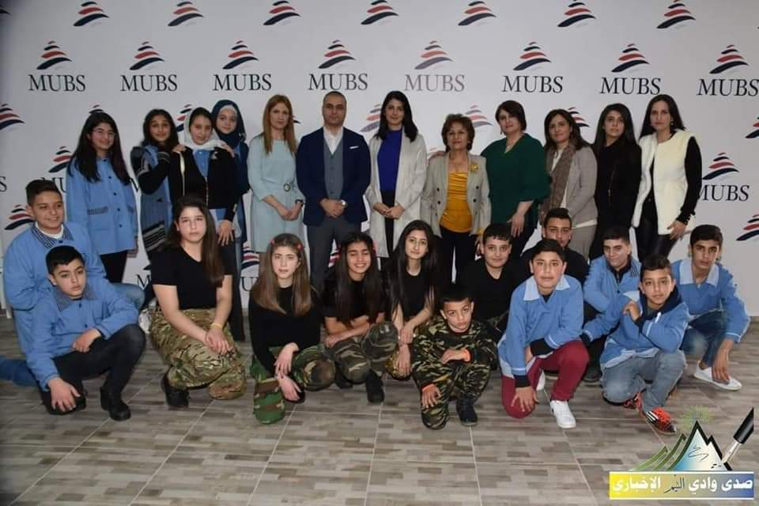
Slide: # 22
Project Funded by WHO: Supporting School Health in Disadvantaged Rural Areas
The awareness sessions piloting four WHO e-modules (reproductive health, physical activity, smoking, and road safety) were led by MUBS researchers who offered a series of awareness sessions to 300 parents in the area.
Notes:
The pilot project was launched in December and will end in February 2019. The first workshop was held by WHO in MUBS Spears campus, to train the coaches and provide them with an overview about the Program that will impact the under-served local community including teachers, students and their parents.

Slide 25
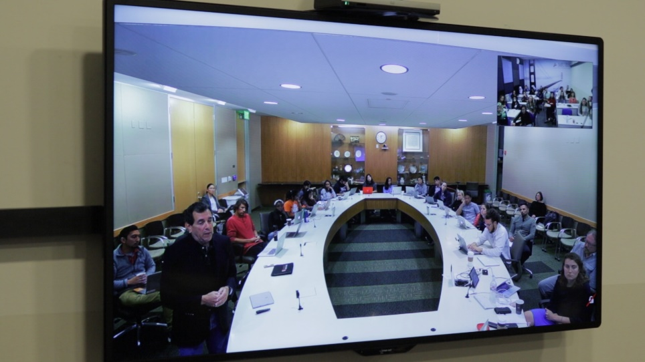
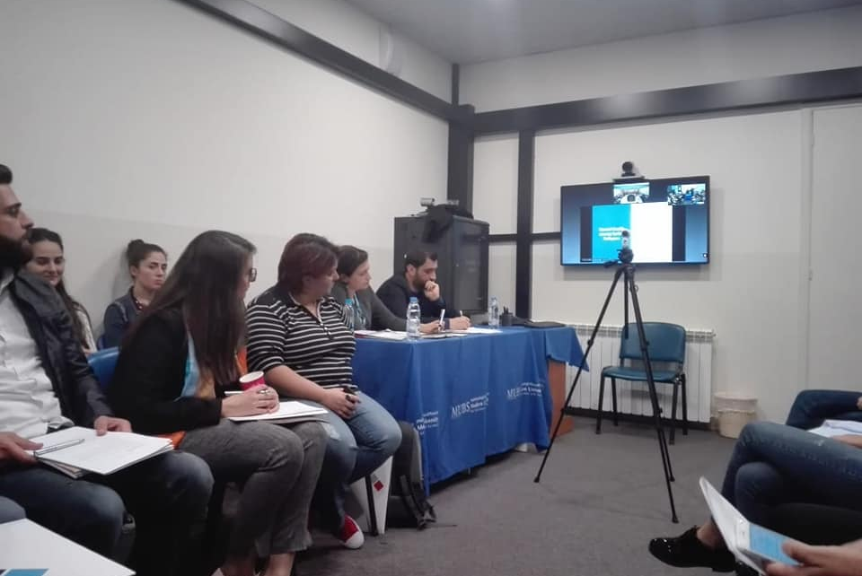
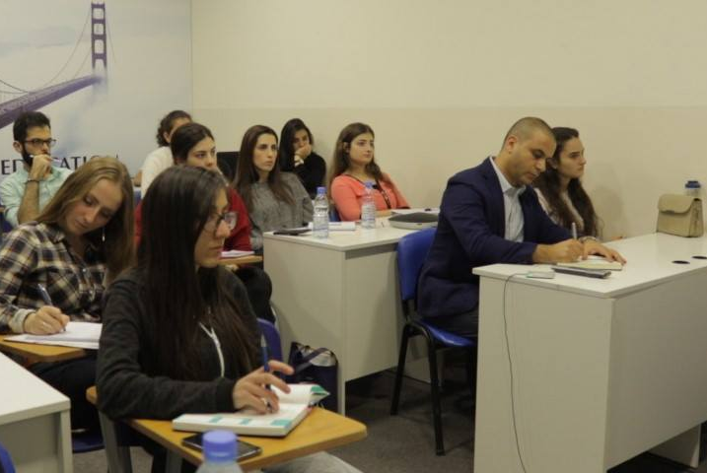
Slide: # 23
Virtual Exchange Program – MUBS and Cardiff Met. University: a joint course on “Humanitarian Relief and Health”
Introducing a set of public health problems/challenges experienced by people affected by natural disasters and/or conflict.
Discussing many changes in people’s lives when they are uprooted by a disaster, ranging from changes in disease patterns, access to healthcare, livelihoods, shelter, sanitary conditions, nutritional status, etc…

Slide 26
Slide: # 24
Virtual Exchange Program – MUBS and Cardiff Met. University : a joint course on “Humanitarian Relief and Health”
Providing a multidimensional understanding of the system in charge of protecting the rights of the victims of humanitarian disasters.
Students had several common online sessions to answer questions posted.
Students worked on common projects related to the effect of disaster on food security, shelter, sanitation systems, water, etc. using academic articles and data collected during their camp visit.
https://www.youtube.com/watch?v=-dfUQuz2ptc
Notes:
Students had several common sessions using CISCO to answer questions posted during the flipped classroom sessions and opened discussion based on that. Students worked on common projects regarding the effect of a disaster on food security, shelter, sanitation systems, water, HCS and CDs by using academic articles and the data collected during the Syrian refugee camp visit.

Slide 27
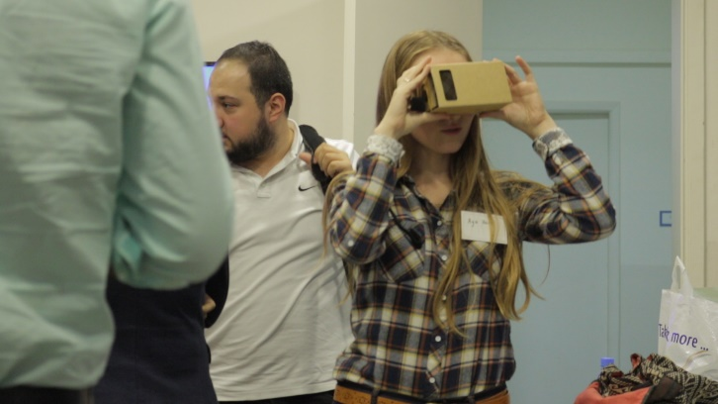
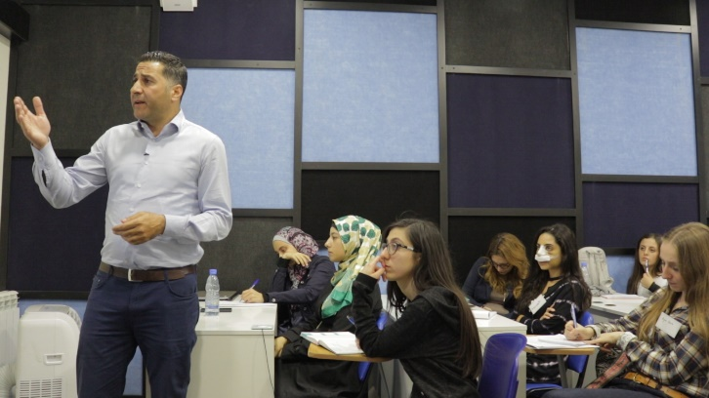
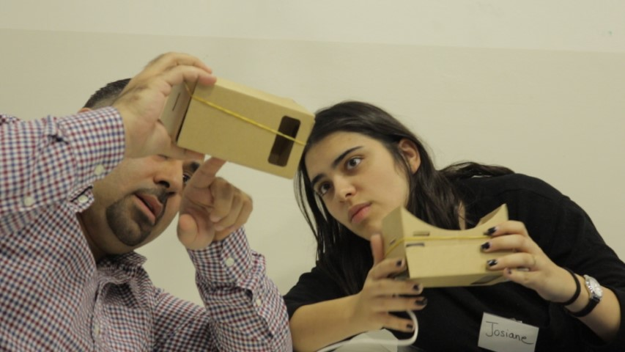
Slide: # 25
Virtual Exchange Program – MUBS and Stanford University: a joint course on “Discussions in Global Health”
Timely topics in global health were presented connecting classrooms in Beirut and Palo Alto, California.
Students worked on and discussed a range of topics in global health including coordinated response to crises, ethical approaches to research and implementation in low-income countries, and refugee health.
By integrating lectures, guest speakers, and a cross-cultural collaborative capstone project, students gained an in-depth understanding of the global-health landscape and methods of addressing complex issues with partners abroad.
Notes:
Another amazing experience witnessed by our students is the joint course on…. The course culminated with two MUBS students traveling to the Bay Area in California to visit the campuses of Stanford, Facebook, Apple, Google, and Silicon Valley organizations working towards finding innovative solutions to challenges in global health. The students, whose five-day trip expenses are fully covered by MUBS, will be chosen by a jury headed by Dr. Alami, based on student participation and quality of work on the capstone joint project.
who won Stanford Mental Health: train mothers in the camp how to detect mental problems among their children and provide them with psychological problems.

Slide 28
Thank you

