Slide 1
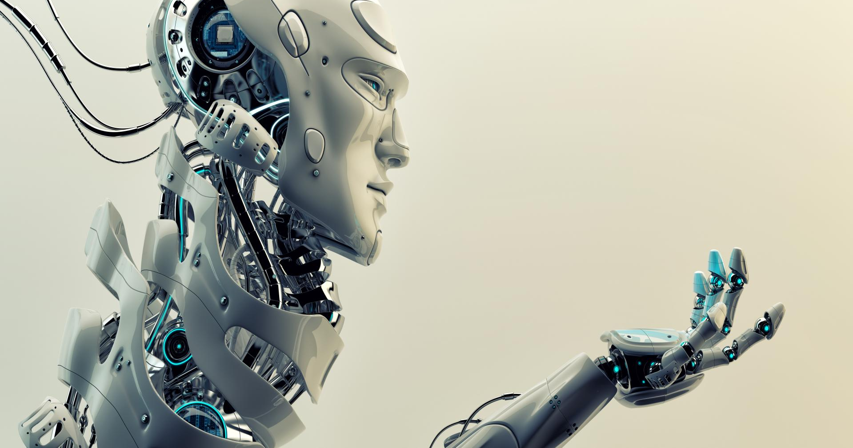
TalTech – leading Estonia and the world into a sustainable digital future
International Cooperation Division

Slide 2
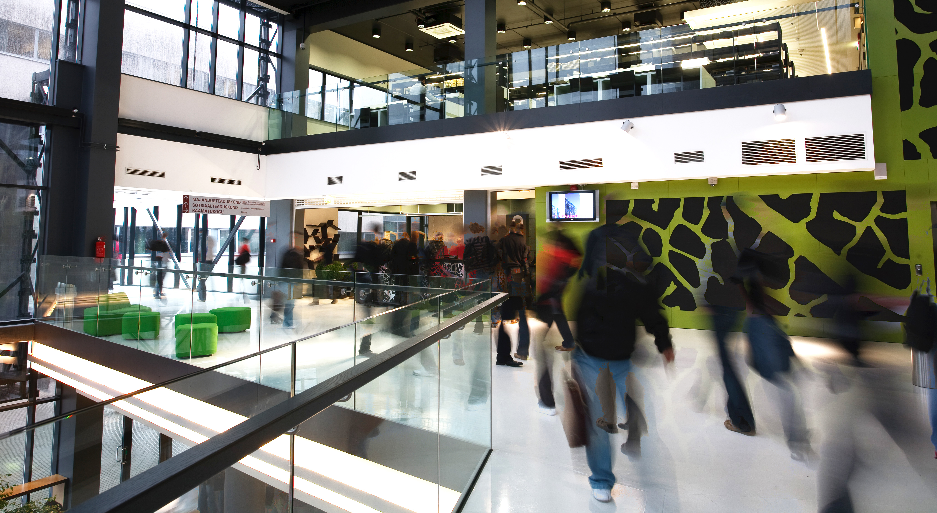
TALTECH UNIVERSITY –
CREATING A BRIGHTER FUTURE!
Established in 1918, Tallinn University of Technology (TalTech) is the flagship of Estonian engineering and technology education and research, where higher education can be obtained at all levels in engineering, technological, natural, and social sciences.
The mission of Tallinn University of Technology is to be a promoter of science, technology and innovation and a leading provider of engineering and economic education in Estonia.
TalTech values professionalism and reliability, entrepreneurship and innovation, openness and cooperativeness.

Slide 3
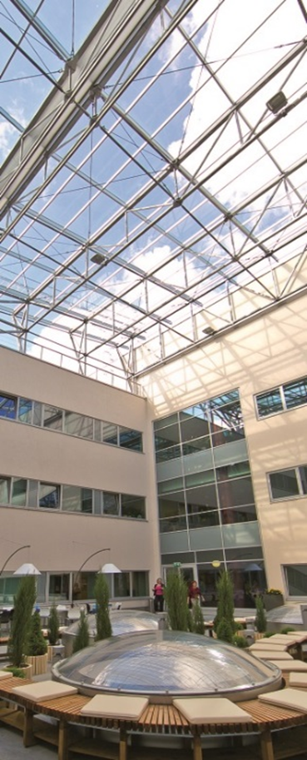
MORE About taltech
Public university, biggest in the capital city
10 282 students in total; 1667 foreign students
Over 1800 employees; 55 different nationalities
QS World University Ranking #651-700; THE World University Rankings #801-1000
Academic partnerships with 700 universities across the world
  KTH Royal Institute of Technology, Chalmers University of Technology, Technical University of Denmark, Technical University of Munich, École Polytechnique, Aalto Univeristy, Czech Technical University in Prague, National University of Singapore, Eindhoven University of Technology, etc.
5 Schools: IT, Engineering, Science, Business and Government, Maritime Academy
Starting November 2020, EuroTeQ Engineering University (European Universities Initiative)
New Rector Prof. Tiit Land and mmanagement since September 2020

Slide 4




OUR STRENGHTS

Slide 5
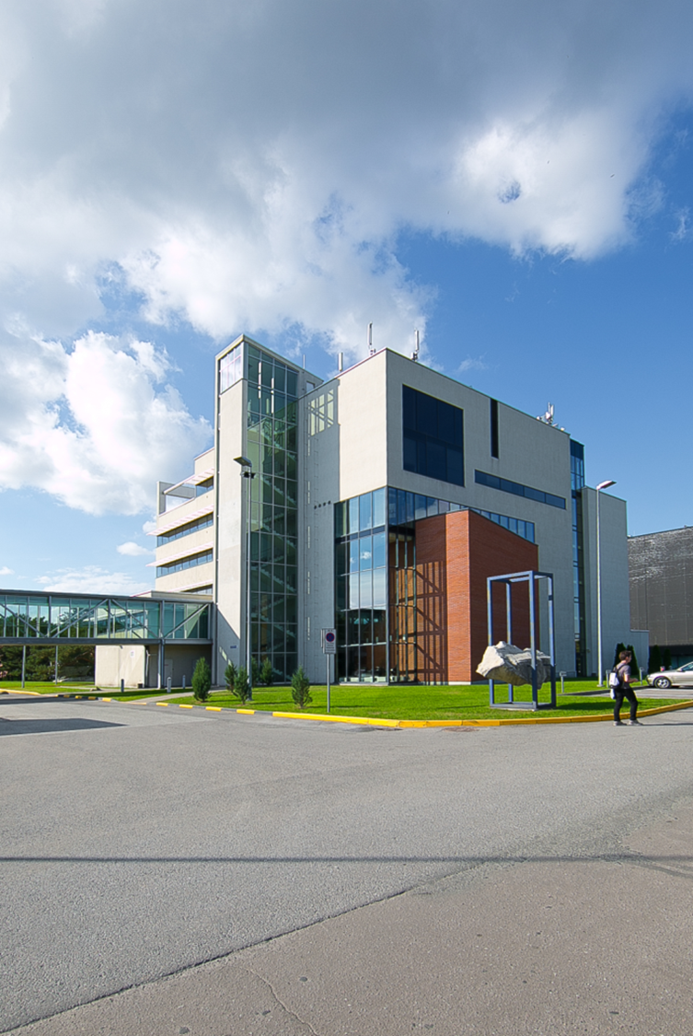
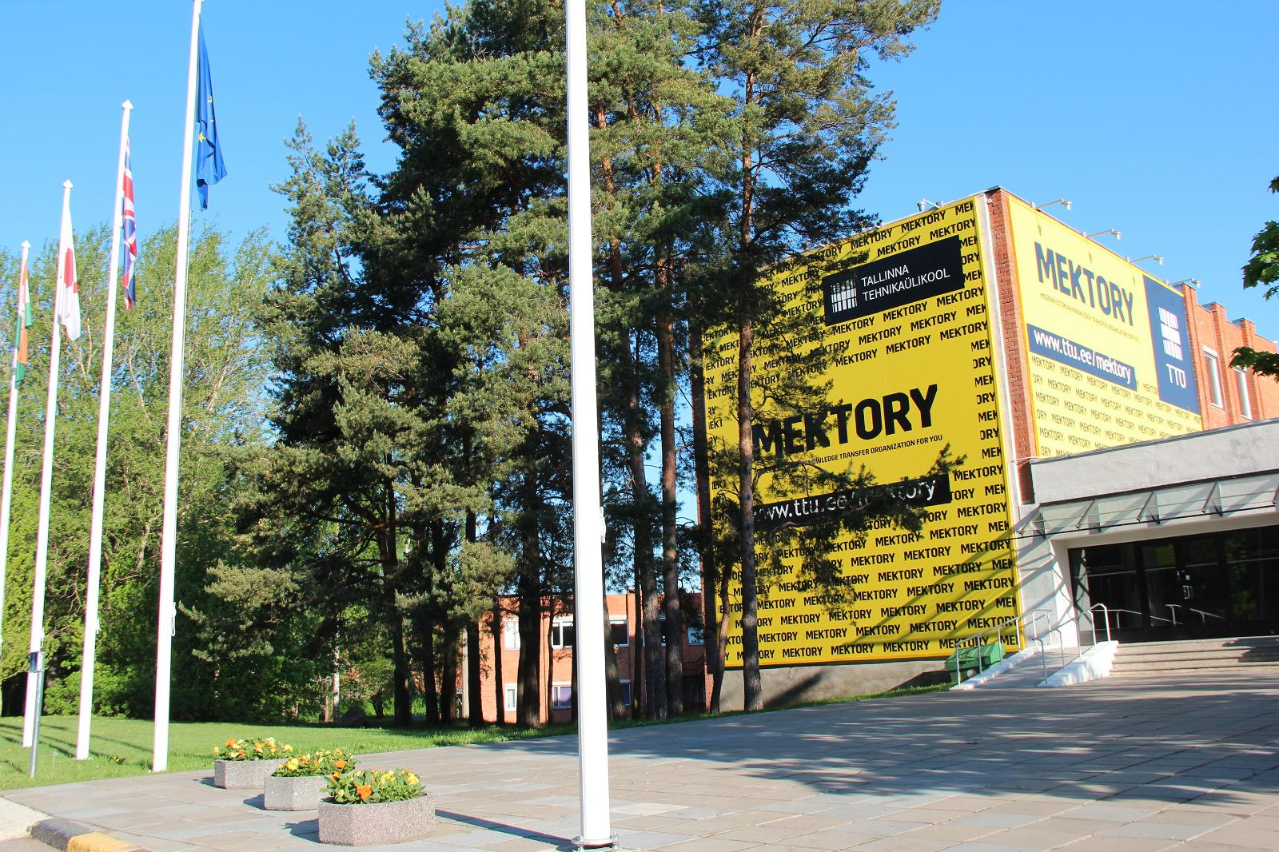
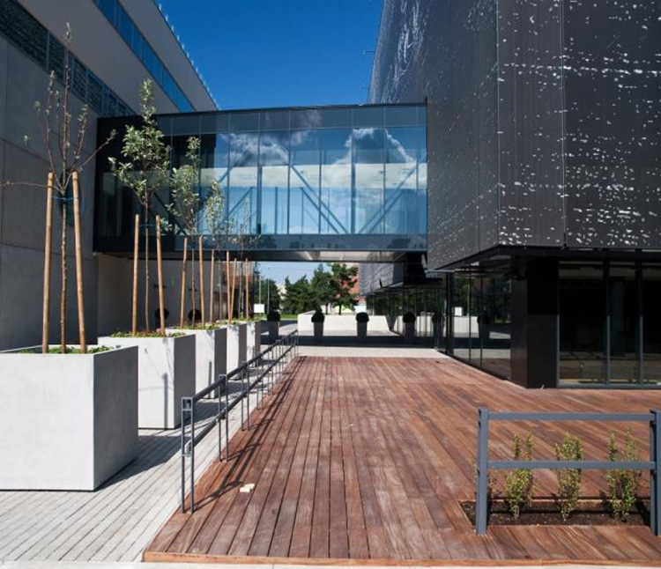
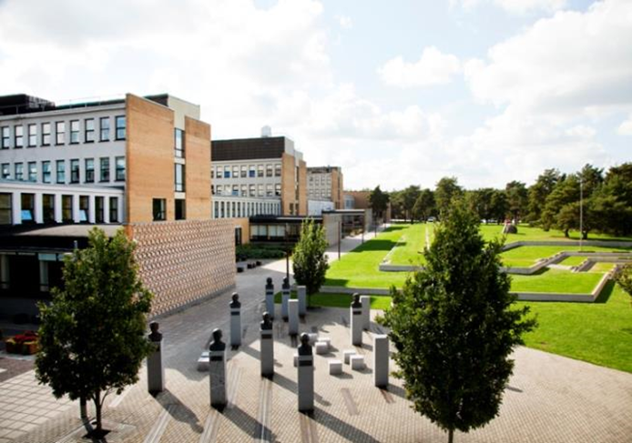
Campus

Slide 6
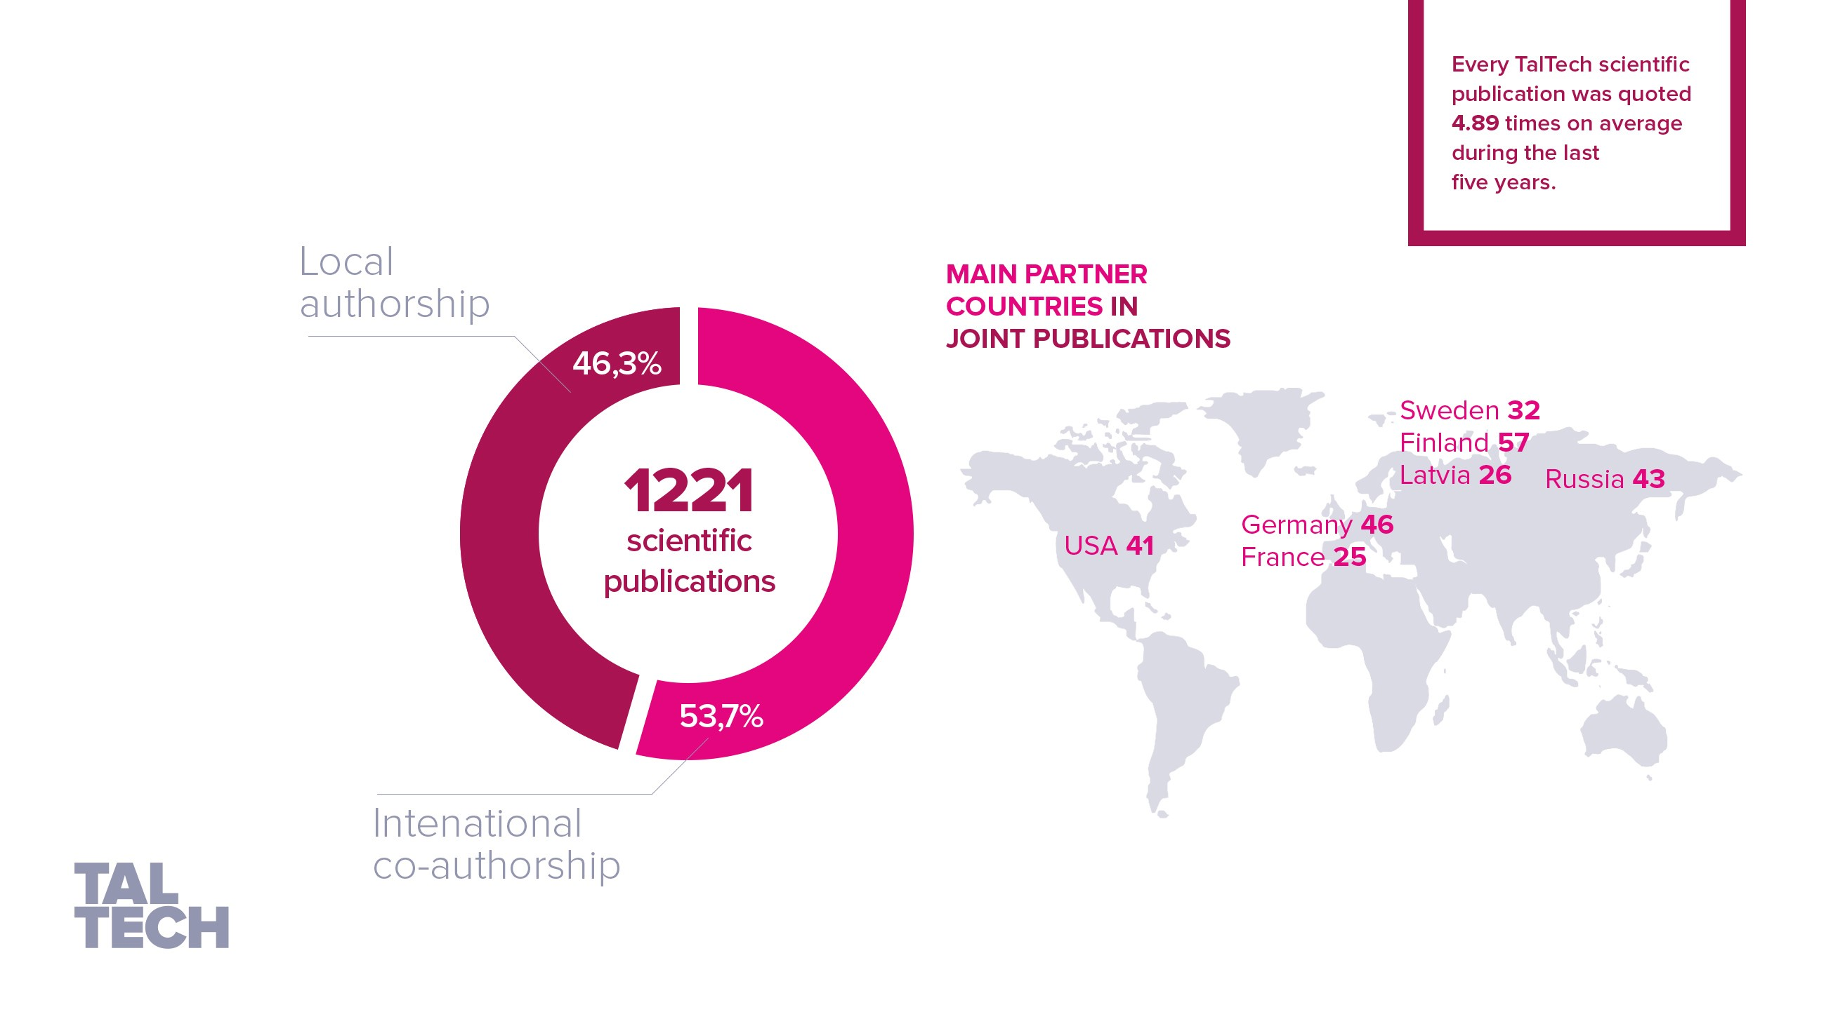
Every TalTech scientific
publication was cited
4.89 times on average
during the last
five years.
RESEARCH AND
DEVELOPMENT

Slide 7

TALTECH’S TOP 12
RESEARCH AREAS AROUND THE WORLD
Smart and sustainable cities
Digitalization of industry and transport
Smart electricity networks and energy transformation technologies
Additive layer technologies
Solar energy and nanomaterials
Bio robotics
The digital transformation
in society, the economy and government
Economic trends and business technologies
Development of a drug tester based
on capillary electrophoresis
Oceanography
and dynamics of coastal seas
Marine technology and hydrodynamics
Cybersecurity
Notes:
Tegemist on esialgse määratlusega teadus- ja uurimistöö valdkondadest, mille osas on TalTechil maailma mastaabis tugev konkurentsivõime.
Töö on pooleli, koordineerib Joosep Kaasik, ja tema alluvuses Mari-Öö Sarv Turundusosakonnast, kellelt tasub projekti käigus uut infot küsida (praegune määratlus veebruarist 2019), ka võivad muutuda valdkondade nimed.
Graafika on loovagentuuri poolt tehtud, projekti lõppetes kasub küsida Turundusosakonnalt graafilist lahendust ja võimalusel praegune välja vahetada.

Slide 8
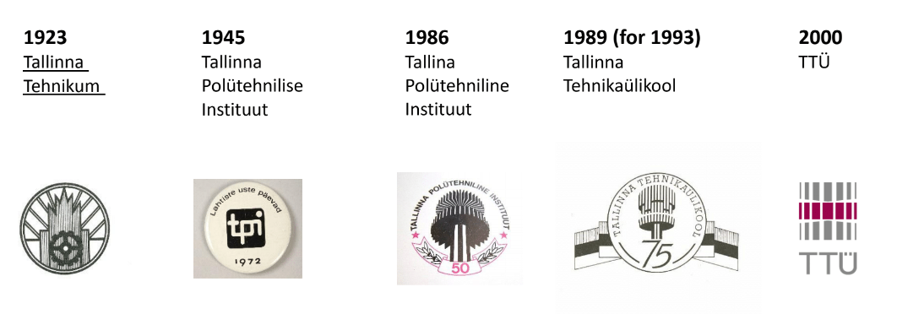


EVOLUTION of taltech
2018
TalTech

Slide 9
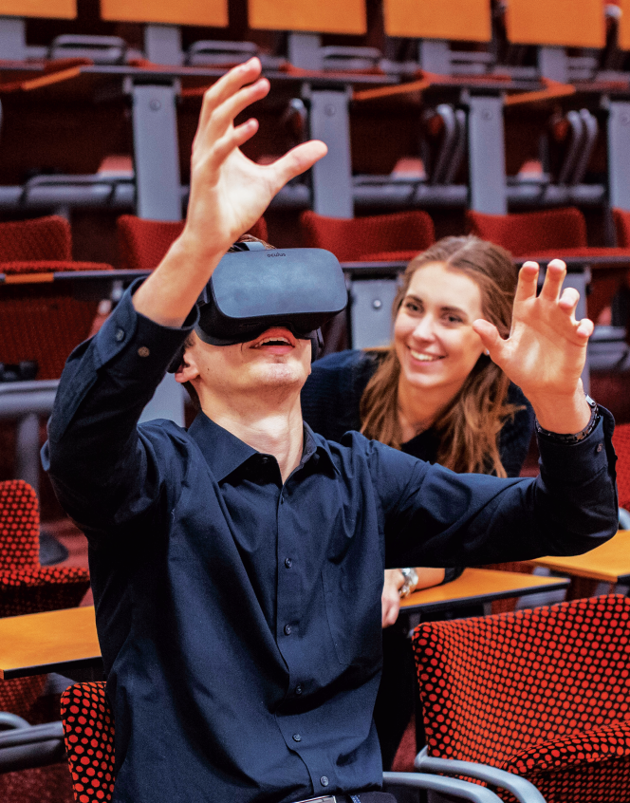
TalTech digital
In order to have a say in the digital society and lead by example, the University has launched the TalTech Digital initiative.
TalTech Digital’s ambition is to transform TalTech into the world’s most digitally advanced university by using and developing the latest technologies in the best possible way. TalTech Digital is based on four pillars:
1 – digital infrastructure, i.e. the world’s most digitally advanced campus;
2 – digital teaching, i.e. integrating new technologies into study programmes;
3 – research lighthouses, i.e. pooling excellence of future-oriented areas of research in TalTech;
4 - digital forum, i.e. a social platform for collaboration and discussions on digital topics with an aim to build a strong digital society in Estonia.

Slide 10
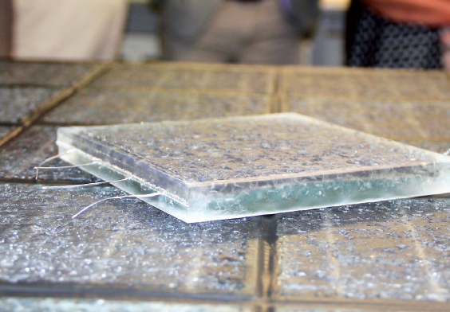
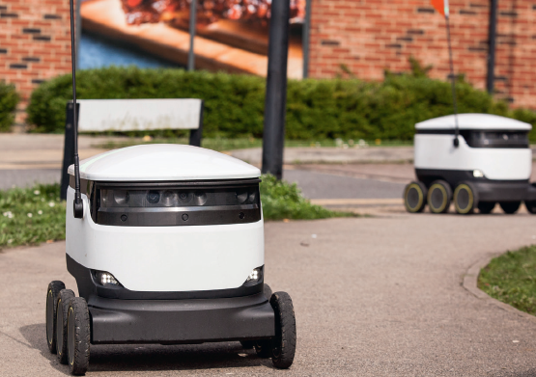
Smart City. Smart campus.
We will build a smart digital campus with smart traffic signs, barriers and charging points for self-driving vehicles.
Smart road pavement that produces electricity from solar energy and uses it to melt snow and ice from the pavement and illuminate the road is already being tested.
Cooperation is carried out with a company that develops smart traffic signs to ensure communication between autonomous vehicles and objects. At the TalTech campus there is one of the first smart pedestrian crossing signs.
We will bring other self-driving vehicles to campus to develop communication between them.
There are courses directly linked to the project of the smart campus and the autonomous vehicle and the students can put their knowledge into practice right here.

Slide 11
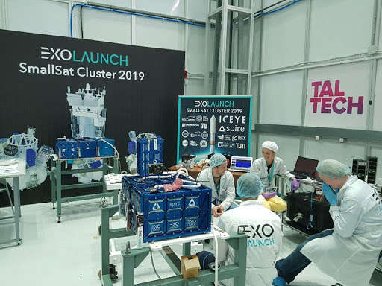
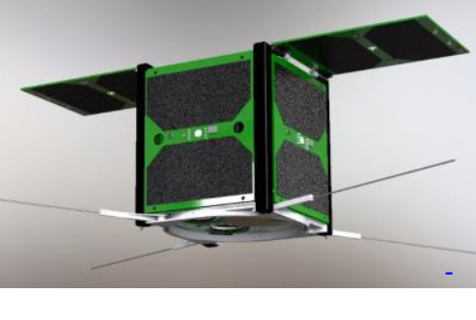
Taltech Satellite programme
The main mission of the TalTech satellites is Earth observation and demonstration of Earth observation technologies.
The satellites includes cameras, image processing and communication with ground-station.
For cameras we are using RGB sensor for visual light image and NIR sensor for near-infrared image that can be used for assessing vegetation growth, climate, geology and sea conditions.
Image processing on the satellites makes sure that we download only those images that provide valuable information.
First satellite „Koit/Dawn“ was launched on July 5th, 2019 from Vostoschnoy Cosmodrome
Second satellite „Hämarik/Dusk“ was launched on September 3rd, 2020.

Slide 12
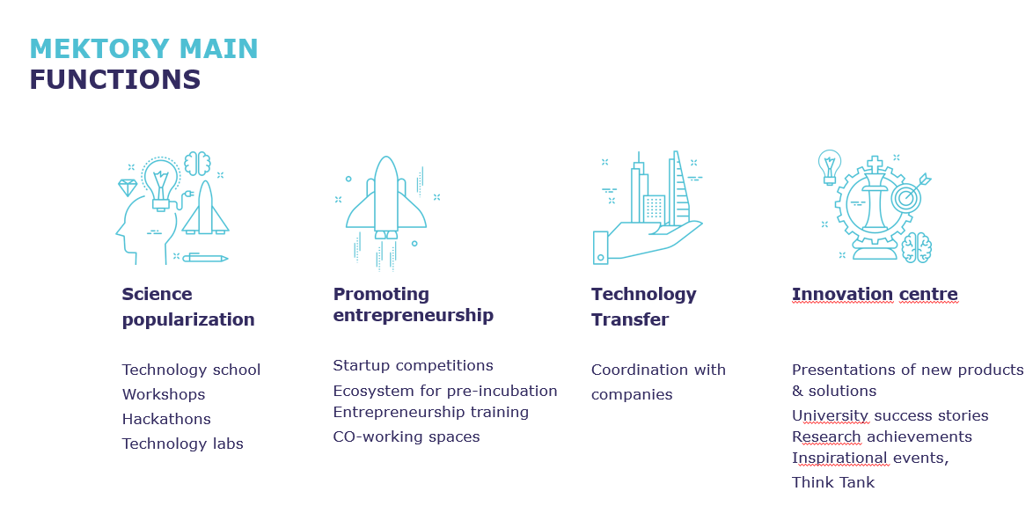
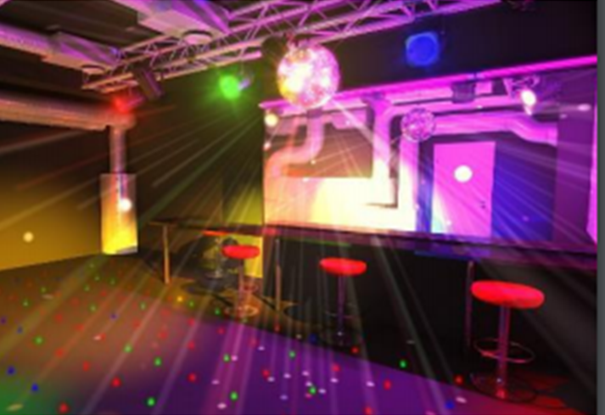
Mektory innovation and business Centre!

Slide 13






Entrepreneurial and innovative
On the campus:
150 high tech companies on Science Park
Mektory business & innovation center
Start-up incubator
Start-up pre-incubation programme
Cooperation with leading global companies e.g. Microsoft, Google, IBM, Samsung, Mitsubishi, ABB, etc.
Start-up competitions, projects with companies and researchers, internships

Slide 14

TALLINN UNIVERSITY OF TECHNOLOGY
Ehitajate tee 5, 19086 Tallinn, Estonia
taltech.ee

